Slide 1


How to make your data work for you?
Božidar Stojanović, Key Account Manager

Slide 2

Serbia 3
Comtrade Group
Comtrade System Integration: Serbia, Slovenia, Bosnia and Herzegovina
Comtrade Distribution:
Serbia, Croatia, Slovenia, Montenegro, Hungary, Romania, Bulgaria, North Macedonia, Bosnia and Herzegovina, Greece, Moldova, Cyprus
Comtrade 360:
Serbia, Slovenia, Ireland, USA
Comtrade Gaming:
Slovenia, Philippines
Slovenia 1
Bosnia and Herzegovina 1
Key numbers
EUR 570+ M
EUR 25 M
4500+
3200+
total revenue in 2022
total EBITDA in 2022
employees
IT experts
Notes:
Comtrade Distribution:
Serbia
Montenegro
Bosnia & Herzegovina
North Macedonia
Slovenia
Croatia
Hungary
Bulgaria
Greece
Comtrade System Integration
Serbia
Bosnia & Herzegovina
Slovenia
Comtrade Solutions
Serbia
Slovenia
USA
Phillippines
Ireland

Slide 3

Simplify. Accelerate. Integrate.
Comtrade System Integration offers advanced solutions based on global IT powerhouses’ technologies, as well as digital transformation services for companies and organizations from various industries.
With more than 20 years of experience and continuous growth in our portfolio, we represent a go-to place for unique, industry-specific software solutions.
Our multi-vendor position allows us to offer most companies everything they need in one place.
1000+
€118 M
450+
clients
revenue in 2022
employees
500+
5
350+
certificates
campuses
active projects
comtradeintegration.com

Slide 4

Digital transformation consulting
About Digital Transformation
Consulting services that provide critical info in areas such as switching to the cloud, data analytics and reporting, process automation, and going digital in general.
Domain expertise
Cyber Security;
Business process automation;
Comtrade Cloud;
ICT networking;
Custom development;
Bizz Apps;
Data& AI.
We are particularly proud of...
Having won Microsoft Partner of the Year in Serbia five times in the last seven years, and Microsoft PotY in Bosnia and Herzegovina after only two years of office establishment in Sarajevo
comtradeintegration.com

Slide 5

Data-Driven Success: The Numbers Speak
Statistics underscore the transformative impact of data-driven strategies in the insurance industry:
80% of insurance customers prefer to interact with their insurers digitally.
Data-driven decision making can lead to a 10% increase in operational efficiency
AI-powered fraud detection systems can save insurers up to $1.7 billion annually.
Chatbots can reduce customer service costs by up to 60%.
comtradeintegration.com

Slide 6
What problems can we solve with AI?
Challenge/Goal
Solution
Improved customer satisfaction
AI chatbot, virtual assistant
Understand your customer
Sentiment analysis
Processes automation
NLP, Email parsing, Text classification
Increase innovation & creativity
Generative AI
Fraud detection and prevention
AI-based Fraud Detection
Personalized Marketing Campaigns
AI-driven Marketing Automation
comtradeintegration.com

Slide 7
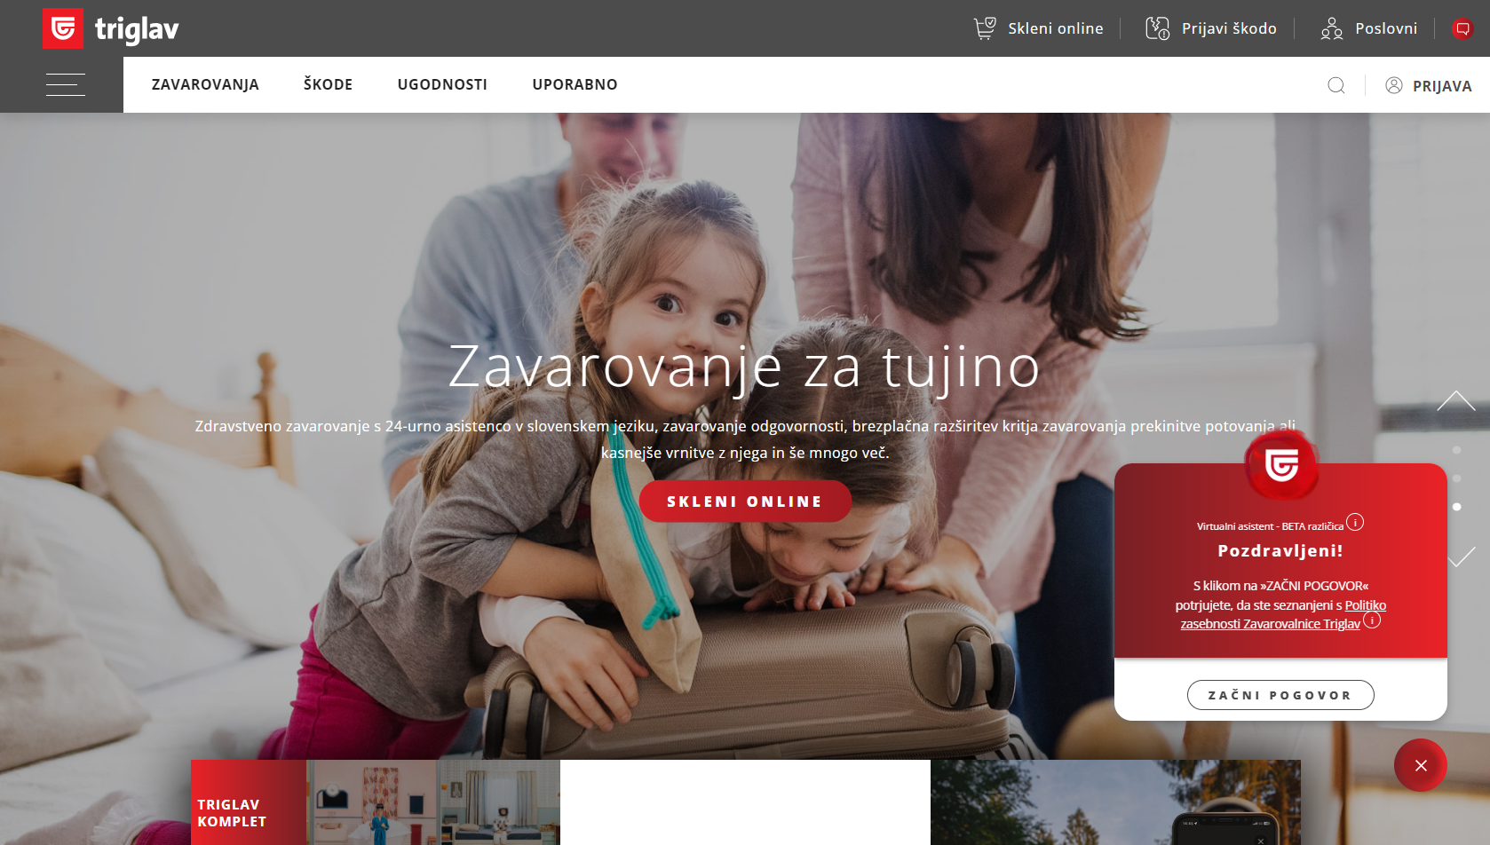






&
Case I
TRIA - AI CHAT BOT
Case II
TRIA - AI INTERNAL HR CHAT BOT
Case III
INFO MAIL
Case IV
TRANSCRIPT CC CALL – SPEECH TO TEXT
This case involves upgrading or replacing the existing Chatbot solution, which currently allows users to obtain information about the ZT offer and potential information related to ZT product and processes through a web interface/conversation.
The objective is to increase the IQ of the ChatBot, offer a maximum number of correct and quality responses to the client, use all available information, reduce calls to the customer center, and increase operational efficiency of support staff.
This case is about the introduction of an internal Chatbot, which will be used by internal stakeholders (employees) for the purpose of obtaining information on HR related topics.
The objective is to ease and speed up the process of obtaining information by employees, respond to general personnel matters tied to internal acts, regulations, legal bases, and internal instructions in the ZT, and save human resources.
This case involves using AI capabilities to respond to all general and concrete emails received. The idea is to have the question prepared by AI and then on the final step confirmed by the agent/human.
The objective is to speed up the time needed to respond, sort emails from info@ to relevant department in Triglav, provide and suggest answers based on past responses and different databases.
This case involves providing "real-time" audio capture (conversation) and a transcription of the conversation, where AI should provide a summary of the call, cause of the call, and suggest a proper response to the customer.
The objective is to provide a summary of the cause and solution of the call based on the transcript and to maintain a content history of interaction with the customer, which can also be useful for other marketing and sales activities.

Slide 8
&
Case I
TRIA - AI CHAT BOT
Case II
TRIA - AI INTERNAL HR CHAT BOT
Case III
INFO MAIL
Case IV
TRANSCRIPT CC CALL – SPEECH TO TEXT
PROVIDE CONTENT AND SUGGESTED ANSWER
This case involves upgrading or replacing the existing Chatbot solution, which currently allows users to obtain information about the ZT offer and potential information related to ZT product and processes through a web interface/conversation.
.
This case is about the introduction of an internal Chatbot, which will be used by internal stakeholders (employees) for the purpose of obtaining information on HR related topics.
This case involves using AI capabilities to respond to all general and concrete emails received. The idea is to have the question prepared by AI and then on the final step confirmed by the agent/human.
.
This case involves providing "real-time" audio capture (conversation) and a transcription of the conversation, where AI should provide a summary of the call, cause of the call, and suggest a proper response to the customer.

Slide 9









Why Comtrade?
comtradeintegration.com

Slide 10
Thank you
www.comtradeintegration.com
Notes:
Super

